Slide 1

THE Data Driven Organization M.DRUMARE

Slide 2
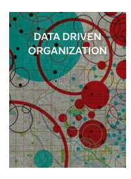
ON FLIPBOARD
http://flip.it/I91PVo

Slide 3
WHAT ?

Slide 4
FROM ANALYTICS TO BIG DATA
3V
Volume
Velocity
Variety
D
Digitalization
2C
Better Capacity of storage, processing at a better Cost.

Slide 5
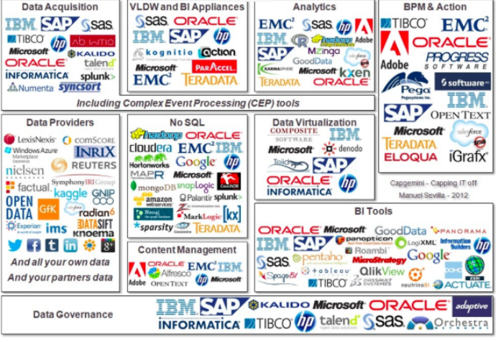
A NEW MESSY AND LUCRATIVE BUSINESS
« Global organizational spending on Big Data exceeded $31 billion in 2013, and is predicted to reach $114 billion in 2018 »
Cap Gemini

Slide 6
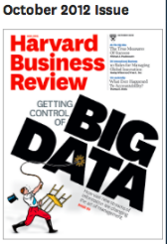

A MANAGERIAL REVOLUTION
A Shift in Management : from "What do we think"
to "What do we know »
New challenge of the management :
Collect and share data
Solve problems Take the right decision as quick as possible
New challenge for the managers :
Use data for their day to day activities to create value and business
« Big Data, the management revolution », HBR, Oct 2012.
https://hbr.org/2012/10/big-data-the-management-revolution

Slide 7
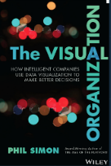
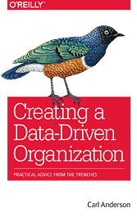
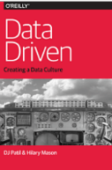
EMERGENCE OF THE DATA-DRIVEN ORGANIZATION

Slide 8











DIGITAL NATIVE AND NON DIGITAL NATIVE
Digital Native
Non Digital Native

Slide 9
FEDEX
In 1978, by FedEx founder and Chairman Fred Smith:
“The information about the package is as important as the package itself.”
Why Fexed drivers took only right turns?
Improvement in fuel savings
Improvement in safety
Reducing wasted time!
« How Big Data Has Delivered For FedEx For 25 Years », Nov 2013.
https://goo.gl/Z8rl1x

Slide 10

GENERAL ELECTRIC
GE offers predictive maintenance.
Remote monitoring and asset tracking services.
Based on the data that it collects from sensor-equipped machines.
GE expects revenues from such services to grow to $5 billion by 2017.
Predix, GE Digital's Platform for the Industrial Internet
Chalk Talk With Harel Kodesh GE Digital

Slide 11
VOLVO
Volvo launched its first car with internet connectivity in 1998, working on combining warranty claim data with telemetry to predict when parts would fail or when vehicles would need servicing.
Today, the company has put data to use in order to uphold its reputation as a maker of safe vehicles and Volvo’s analytic strategy is also improving driver and passenger convenience.
« How the connected car is forcing Volvo to rethink its data strategy » https://lc.cx/o9SS
Volvo works with Teradata to carry out predictive, machine-learning driven analytics across petabyte scale datasets.

Slide 12
BIG DATA IMPROVE BUSINESS & PERFORMANCES
The more companies characterized as data-driven, the better they performed on objective mesures and operational results
+5% more productive
+6% more profitable
Study of MIT Center for Digital Business, 2011.
https://lc.cx/o9SS

Slide 13
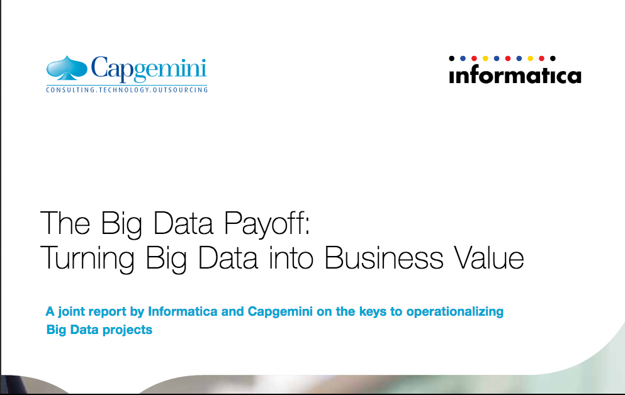
BIG OPPORTUNITIES AND DIFFICULTIES
Nearly 60% of senior executives believe that Big Data will disrupt their industry within the next three years.
Organizations were found to be struggling even with their Proof- of-Concepts (PoCs), with an average success rate of only 38%.
Only 27% of the executives we surveyed described their Big Data initiatives as “successful”.
https://www.capgemini.com/resource-file-access/resource/pdf/the_big_data_payoff_turning_big_data_into_business_value.pdf

Slide 14
HOW TO ?

Slide 15
FACTORS OF SUCCESS
DEVELOP A TECHNOLOGICAL CULTURE.
INVEST IN TECHNOLOGY.
INVEST IN DATA EXPERTISE.
IMPLEMENT A DATA-CENTRIC TEAM STRUCTURE.
CONNECT DATA TO THE BUSINESS.
ADOPT A CUSTOMER-CENTRIC APPROACH.
ADOPT A SMART APPROACH.
ADOPT A LONG TERM STRATEGY.

Slide 16
DEVELOP A TECHNOLOGICAL CULTURE
In 1970’s.....Barcode scanners at the cash register :
What products were selling?
How the placement of those product had on impact on sales?
What are the seasonal trends and regional differences?
First company to invest in RFID Technologies (Radio Frequency Identification)
Today: Walmart has one of the largest collections of data in the world, processing more than 2.5 petabytes of big data, hourly.
Walmart: Big Data, Big Opportunities

Slide 17

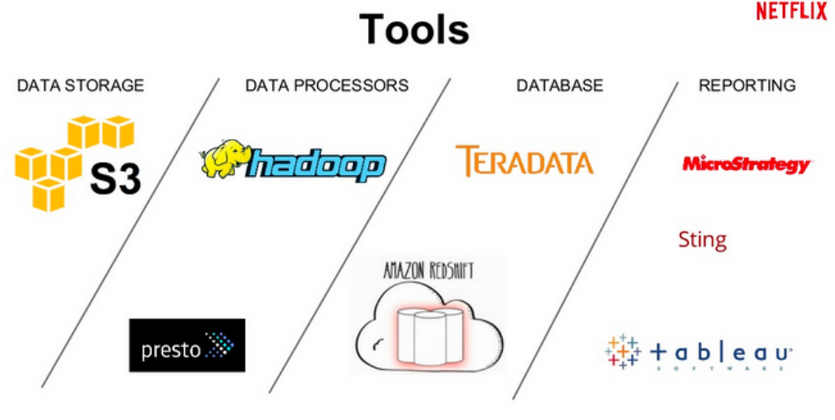
INVEST IN TECHNOLOGY
How Netflix uses Data Analytics to Launch a new TV Series?

Slide 18
HOW TO INVEST IN TECHNOLOGY
Start small with POCs and POTs.
Get familiar with the ecosystem with Iteration.
Recognize the stakeholders in the Company and convince them.
Invest in Data Expertise.
How to invest in a Big Data Platform, Forbes, July 2016
https://lc.cx/o9qE

Slide 19
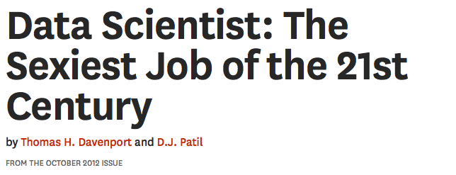
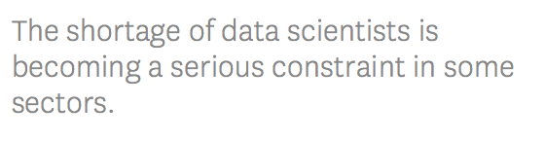
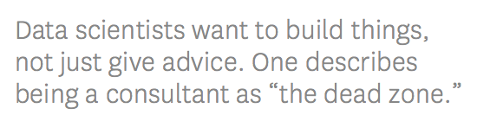
INVEST IN DATA EXPERTISE
« Data Scientist: the Sexiest Job of the 21st Century » , HBR, Oct 2012
https://goo.gl/R8Qdff

Slide 20
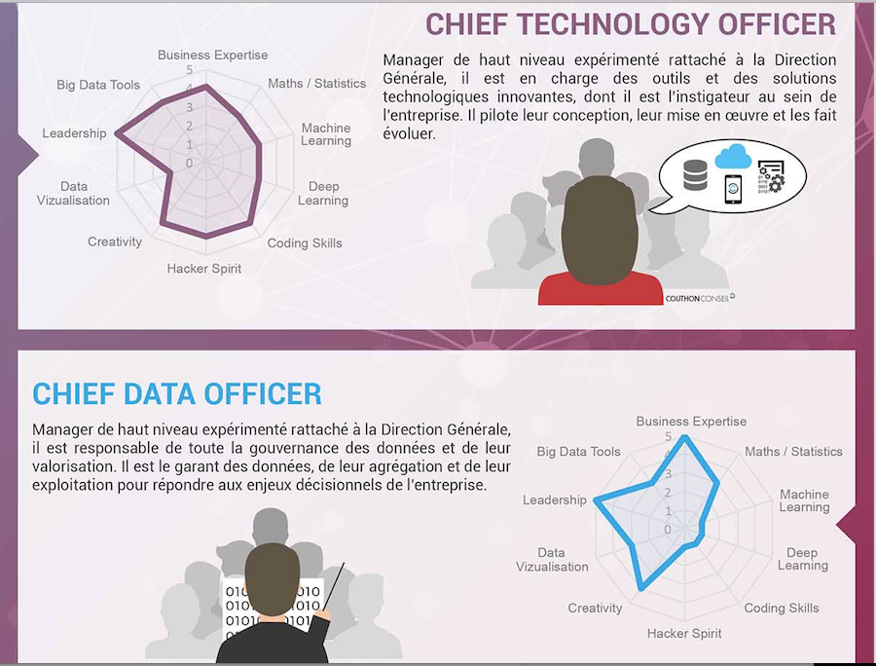
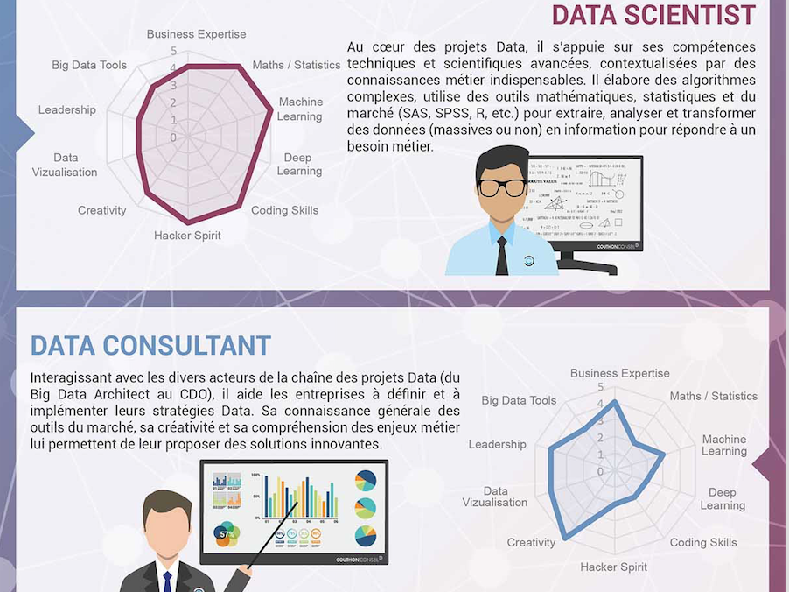
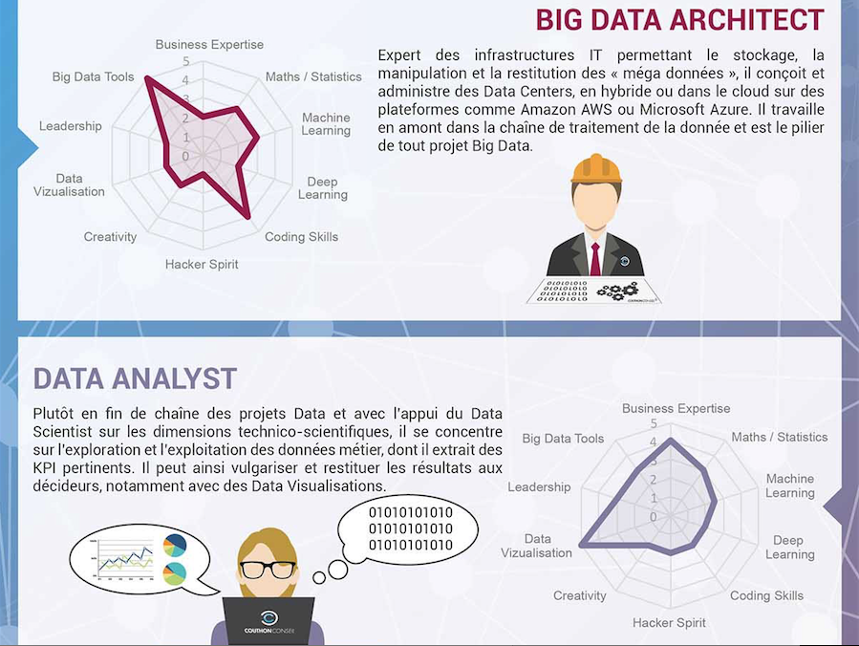
INVEST IN DATA EXPERTISE
« Les 6 métiers porteurs de la Data », Les Echos, April 2016
http://start.lesechos.fr/rejoindre-une-entreprise/actu-recrutement/les-6-metiers-porteurs-dans-la-data-en-une-infographie-4283.php

Slide 21


HOW TO INVEST IN DATA EXPERTISE
Make a Partnership
P&G has partnered with Google to enhance its employees’ analytics skills.
The two companies have engaged in employee exchange programs for the past five years.
While employees from Google gain from P&G’s expertise in advertising, those from P&G get to learn from Google’s expertise in data analytics.

Slide 22
HOW TO INVEST IN DATA EXPERTISE
Make acquisitions and develop Internship
In 2006 . Walmart,has set up “@WalmartLabs”, an innovation center based in Silicon Valley, which is helping the retailer enhance customer experience through innovative uses of Big Data.
@WalmartLabs acquired Inkiru – a startup specializing in predictive analytics – to strengthen its analytics capabilities.
Interns @WalmartLabs Make an Impact on a Scale Like No Other

Slide 23
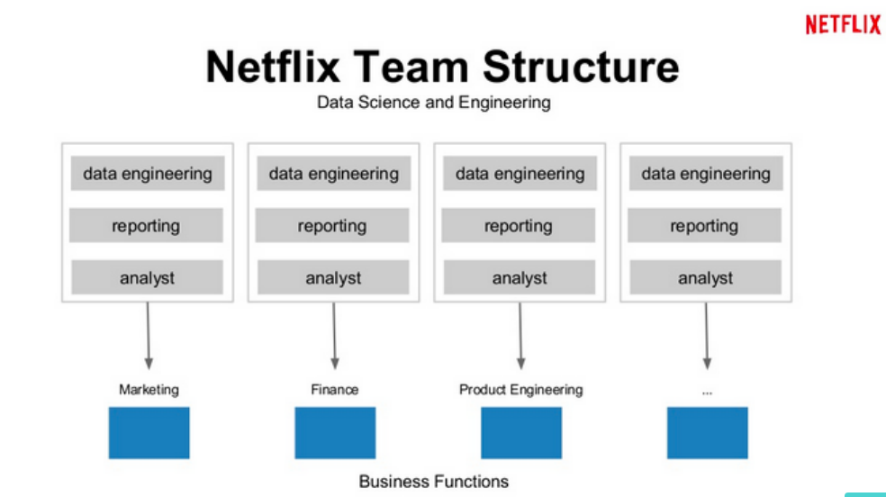
IMPLEMENT A « DATA TEAM STRUCTURE »

Slide 24
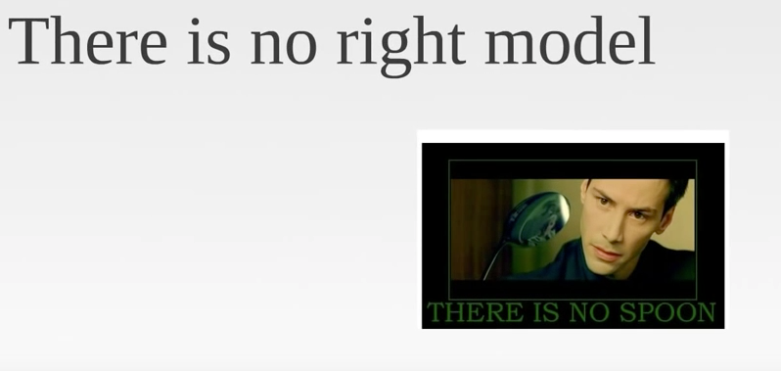
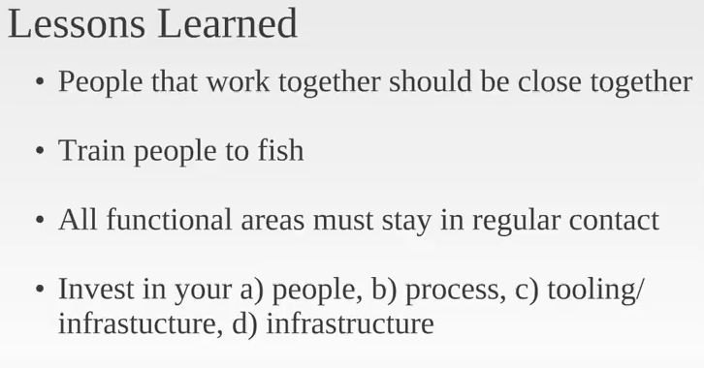
HOW TO IMPLEMENT A DATA TEAM?
DJ Patil, "Data Science and Building Data Teams"
Strata Jumpstart 2011: DJ Patil, "Data Science and Building Data Teams », White House CDO

Slide 25
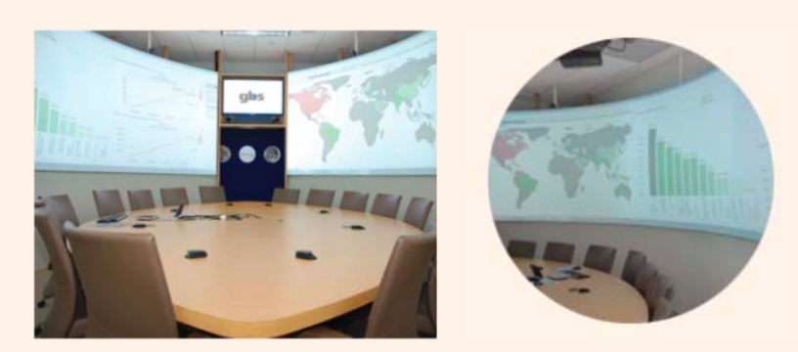
CONNECT DATA TO THE BUSINESS
“Business Spheres”
Executives are physically surrounded by screens that display complex data from a variety of sources.
The visualization techniques employed in Business Sphere facilities help executives uncover opportunities and exceptions from the data and ask focused business questions.
P&G has more than 50 such facilities across the world (first deployment in 2006).
Making $79B Agile: How Procter & Gamble Handles BI

Slide 26
HOW TO CONNECT DATA TO THE BUSINESS
Customized Data Visualisations : Decision Cockpits
Dashboards providing executives with visual displays of data on business performance and market trends.
Customized according to individual needs.
They allow executives to drill-down to granular views of data at a country, brand or product-level.
Also provide real-time automated information alerts.
In 2011, Decision Cockpits have been widely adopted at P&G with more than 58,000 executives using them every week. (first deployment in 2006).
How P&G Presents Data to Decision-Makers, HBR, April 2013
http://urlz.fr/4nOQ

Slide 27
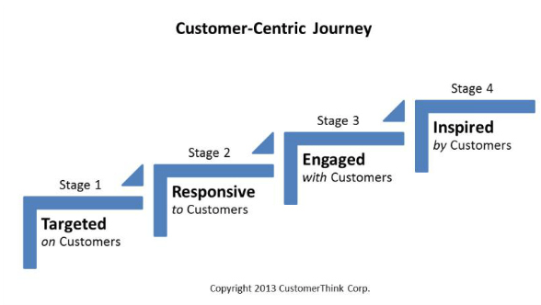
ADOPT A CUSTOMER-CENTRIC APPROACH
Five-customer-centric-marketing-lessons-from-apple-to-zappos, Forbes, August 2014
http://urlz.fr/4nOY

Slide 28
HOW TO ADOPT A CUSTOMER-CENTRIC APPROACH
« In some companies [that are] evolving the product, the product team might be the driver: the team comes up with the idea, design, builds, launches, and sees what happens. »
« My team can't make that decision. We come up with the ideas, but what drives product decisions is our customers and what customers do and how they use the product. »
Netflix Co-founder

Slide 29
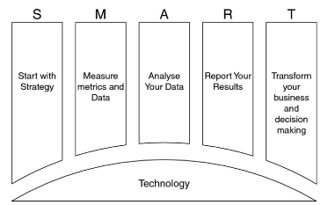
ADOPT A SMART APPROACH : START WITH STRATEGY
Big Data: Using SMART Big Data, Analytics and Metrics To Make Better Decisions, B.Marr

Slide 30
HOW TO ADOPT A SMART APPROACH
A lot of companies waste time and money installing expensive software, putting data on it, hiring data scientists and hoping for some magic to happen.
They realise they’ve learnt a lot more about the tech but nothing new about their business.
The right way to approach : to figure out what decisions are trying to be supported and what data is needed to do that.
Big Data: Don’t put the chart before the horse, Irish Times, May 2016
https://lc.cx/o9NR

Slide 31

ADOPT A LONG TERM STRATEGY
Question : in 2009, 3/4 people would stop using it withing two months.
Challenge : How to deal with this engagement problem ?
2,5 Years of Data Analysis :
Users who had used service at least seven times in their first month were over 90% likely to return in subsequent months
a user followed 30 or more people, was almost certainly to become a long term user.
2/3 of the people who new users followed were purely for content,
1/3 had to follow the new users backs
Action: Twitter improved the user account creation
Result: 20% Increase in long term engagement

Slide 32
IMPACTS ?

Slide 33
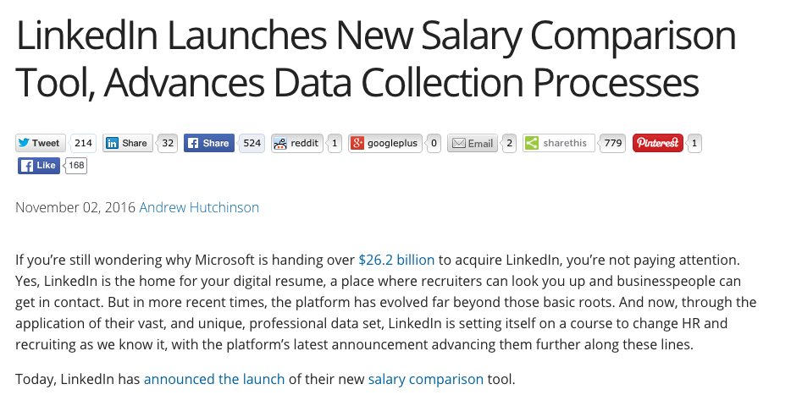

THE EMERGENCE OF DATA-DRIVEN HR
Linkedin Salary : Salary Comparaison
Bob emploi: personalization of the search

Slide 34
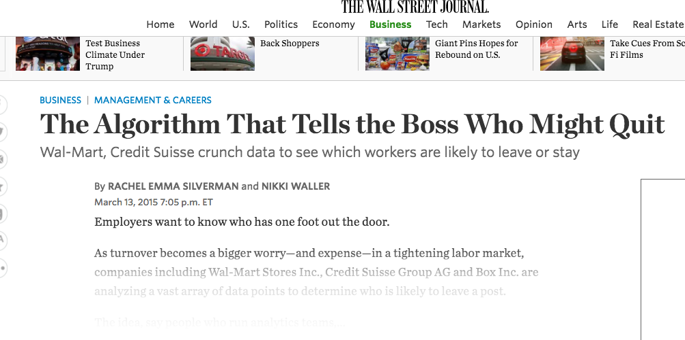
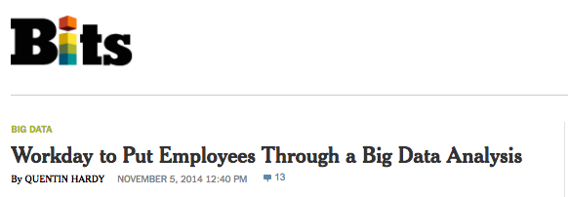
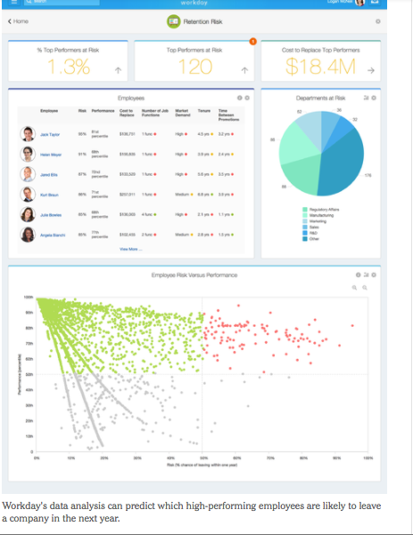
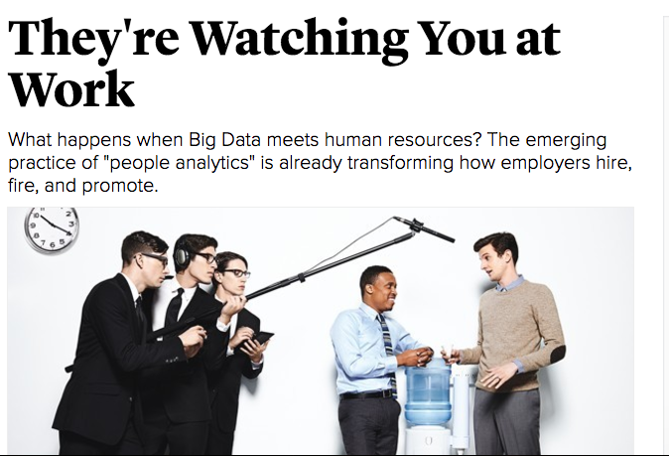
THE EMERGENCE OF DATA-DRIVEN HR

Slide 35
THE EMERGENCE OF THE DATA-DRIVEN DECISION MANAGEMENT (DDDM)
With the adoption of Big Data, managers will useless if they only give answers not asking the right questions highlighted by the data.
Managers will have to challenge the data collected :
What the data is saying?
How confident are they in the dashboards and other data reports?
Big Data, the Management revolution , HBR, 2012
http://urlz.fr/4nRc

Slide 36
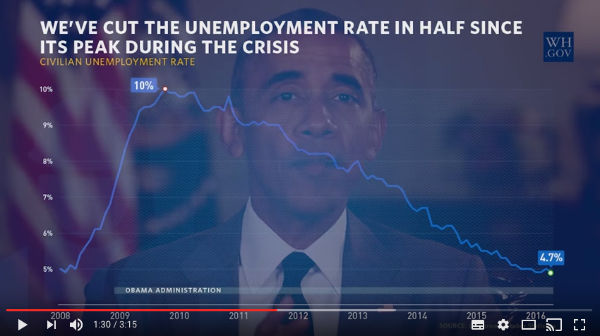
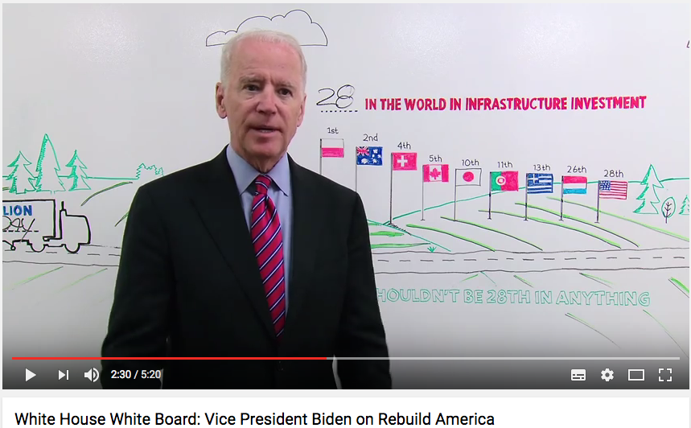
THE EMERGENCE OF THE VISUAL MANAGER
Weekly Address: Building on America’s Economic Recovery
White House White Board: Vice President Biden on Rebuild America

Slide 37



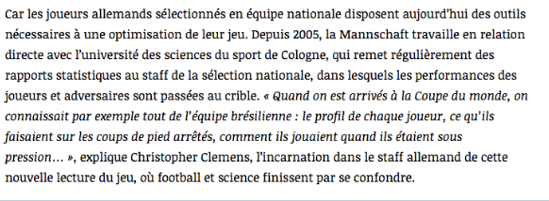
THE EMERGENCE OF THE DATA-DRIVEN PERFORMANCE
New way to generate Performance
L’Equipe explore la data revolution dans le Sport
https://lc.cx/hSL
Moneyball (2011)

